Slide 1

Customer Shopping Behavior Analysis
Understanding customer spending, preferences, and subscription impact for better business decisions.

Slide 2

Project Overview: Unlocking Customer Insights
Data-Driven Insights
Analyzed 3,900 purchase transactions.
Key Objectives
Understand spending, customer differences, product preferences, and subscription effects.
Strategic Impact
Empower businesses with actionable insights for decision-making.

Slide 3

Dataset Summary: The Foundation of Our Analysis
Total Records: 3,900 transactions
Total Columns: 18 detailed attributes
Key Information: Customer demographics (age, gender, location, subscription), purchase details (product, category, price, season, size, color), and behavior (discounts, past purchases, frequency, reviews, shipping).
Missing Data: 37 values in 'review rating' column.

Slide 4

Exploratory Data Analysis (EDA) in Python
01
Data Loading & Initial Exploration
Imported dataset with pandas; checked structure and summary statistics.
02
Data Cleaning & Handling
Imputed missing review ratings using median per category.
03
Standardization & Feature Engineering
Renamed columns, created age groups and purchase frequency.
04
Database Integration
Loaded cleaned data into PostgreSQL for SQL analysis.

Slide 5
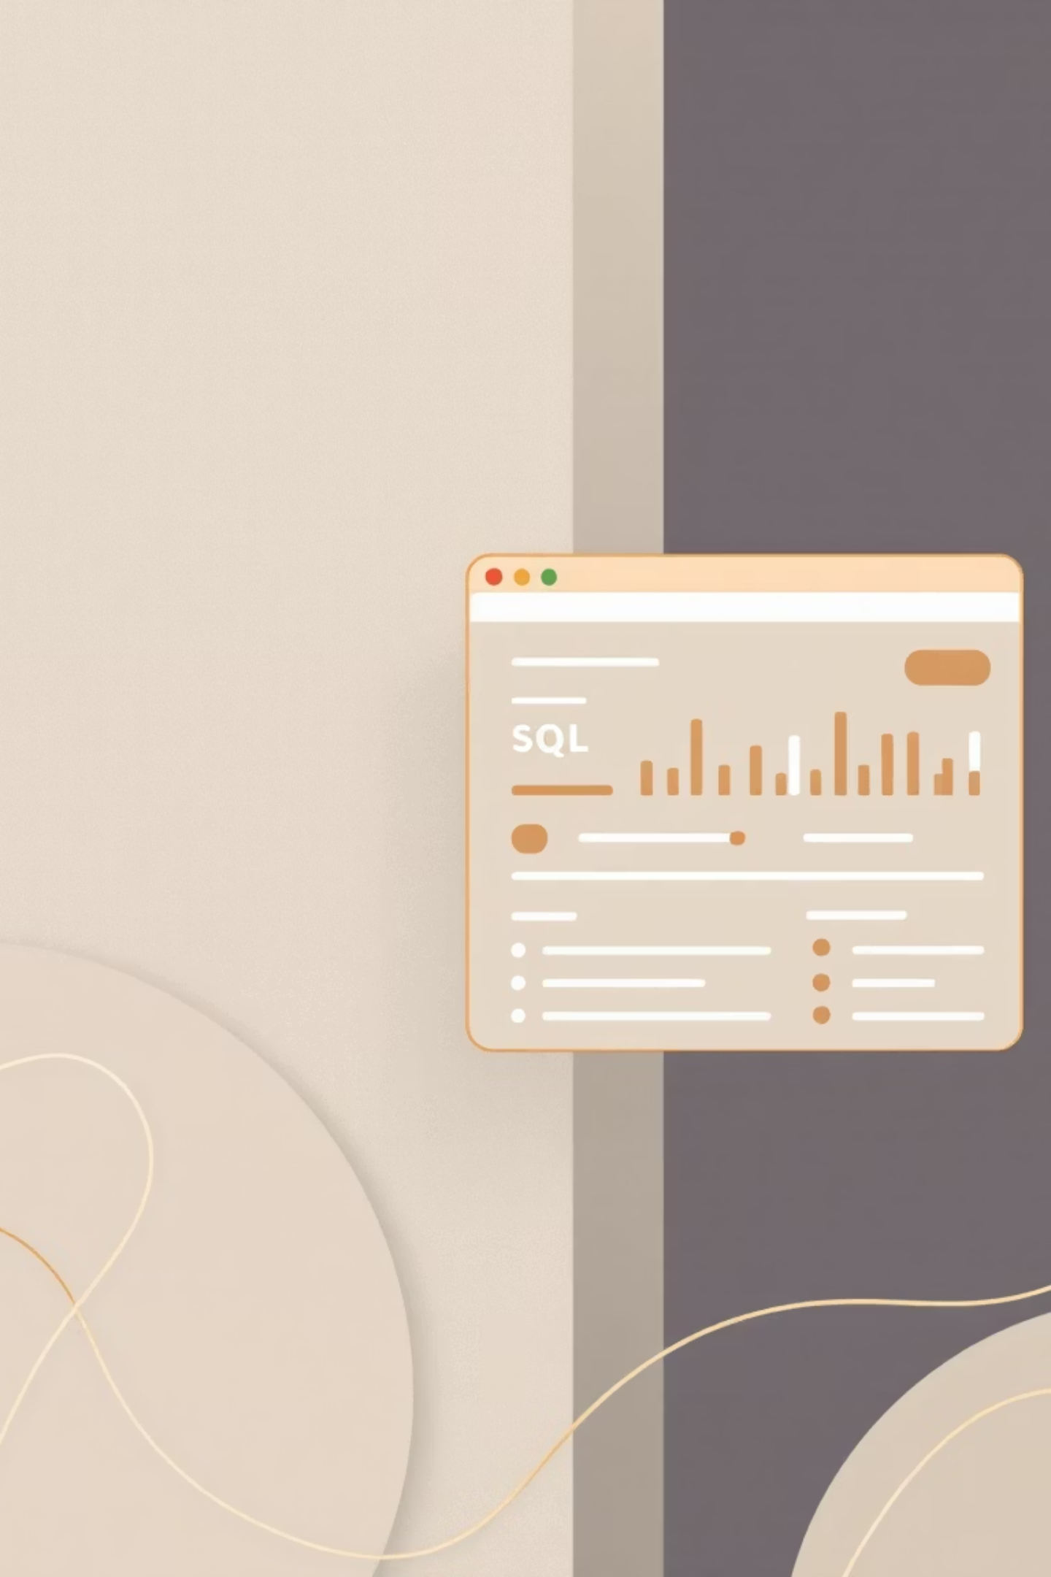
Key Business Questions Answered with SQL
1
Revenue by Gender
Compared total revenue from male vs. female customers.
2
High-Spending Discount Users
Identified customers using discounts but spending above average.
3
Top 5 Products by Rating
Found products with the highest average review ratings.
4
Shipping Type Comparison
Average purchase amounts for Standard vs. Express shipping.

Slide 6

SQL Analysis: Deep Dive into Customer Behavior
Subscribers vs. Non-Subscribers
Compared average spend and total revenue by subscription status.
Discount-Dependent Products
Identified top 5 products with highest percentage of discounted purchases.
Customer Segmentation
Classified customers: New, Returning, Loyal based on purchase history.
Top 3 Products per Category
Listed most purchased products within each category.

Slide 7

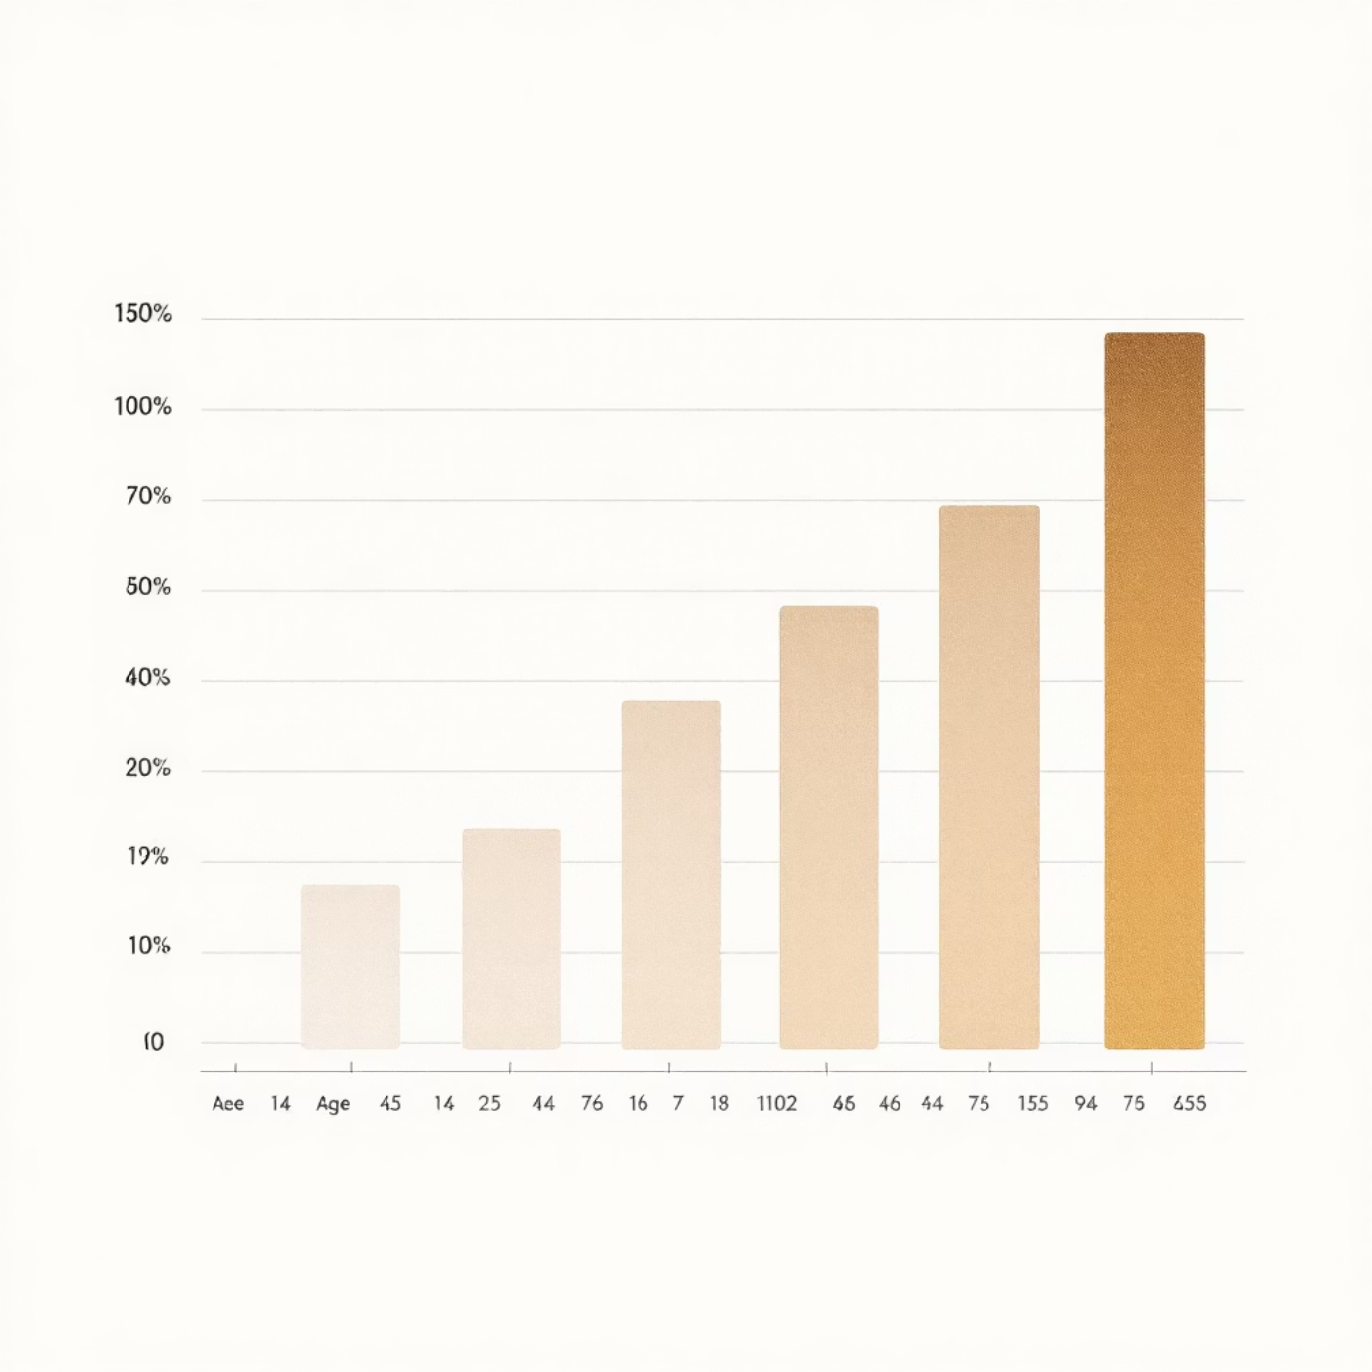
SQL Analysis: Uncovering Purchase Patterns
Repeat Buyers & Subscriptions
Revenue by Age Group
Customers with >5 purchases are more likely to subscribe.
Calculated total revenue contribution from each age group.

Slide 8
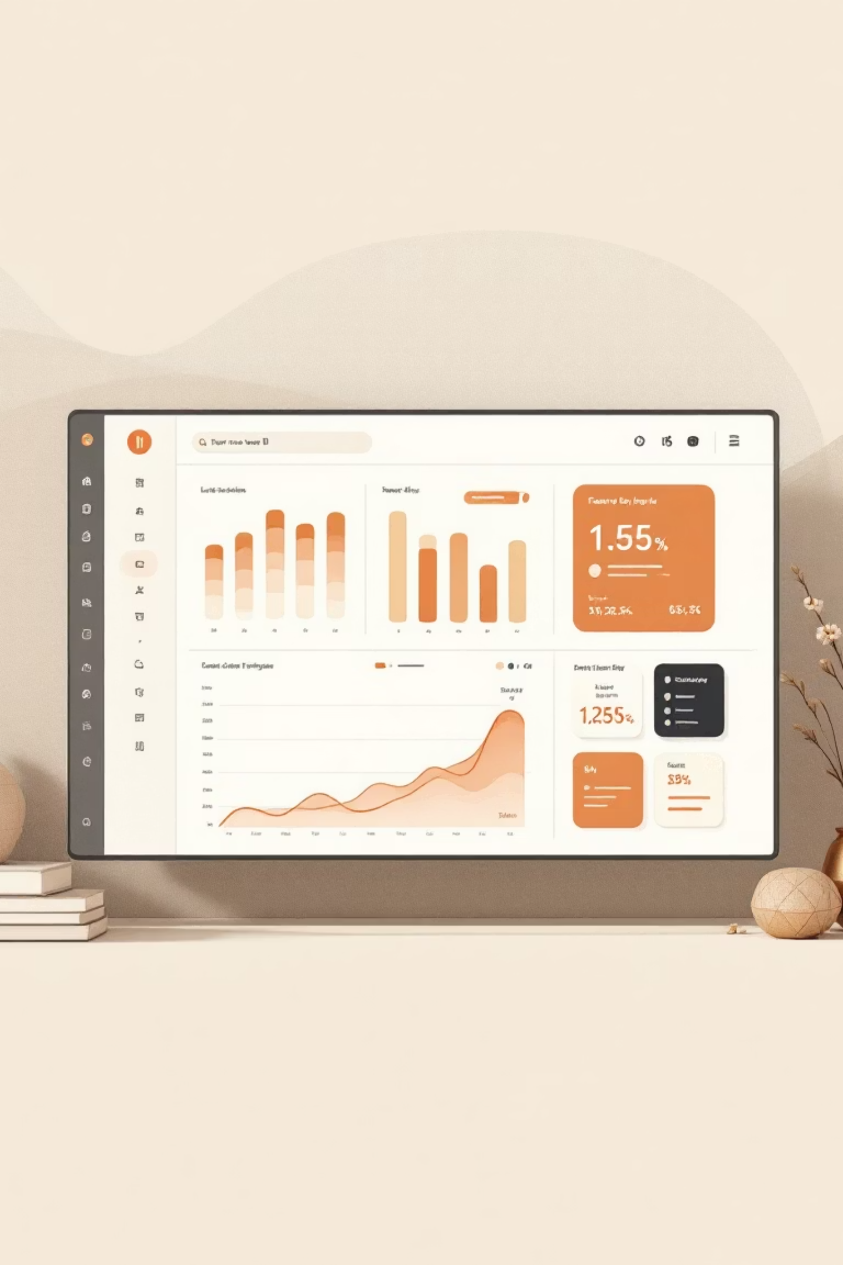
Interactive Dashboard in Power BI
Visualizing insights for easy comprehension and decision-making.

Slide 9


Business Recommendations: Driving Growth
Boost Subscriptions
Offer special benefits and rewards.
Reward Loyalty
Incentivize repeat customers.
Smart Discounts
Use discounts strategically to increase sales without reducing profits.
Focus Marketing
Prioritize best-selling and highly-rated products.

Slide 10





Strategic Growth Initiatives
Fast Shipping Focus
Target Adults
Market to customers who prefer express delivery.
Focus on high-revenue age groups.
Senior Discounts
Offer incentives to senior customers.
Better Reviews
Actively collect and leverage product reviews.
Improve Online Sales
Enhance e-commerce experience.

